Slide 1

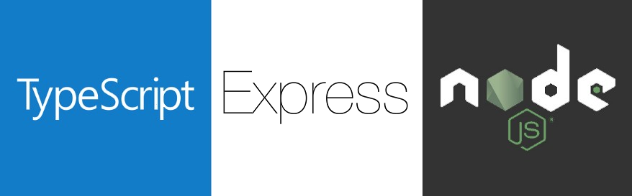
TypeScript integration
JavaScript Runtime
On Server Side

Slide 2
TypeScript Integration
npm init
npm install express ejs --save
npm install typescript ts-node ts-node-dev @types/node @types/express --save-dev

Slide 3
Modules Overview
Module | Description
express | Web Framework
typescript | Viết mã sử dụng TypeScript, biên dịch ra file javascript
ts-node | Use to run TypeScript files directly.
ts-node-dev | Running TypeScript without transpiling
ejs | Template engine

Slide 4
Scripts Configuration
"scripts": { "tsc": "tsc", “start:dev": "ts-node-dev --respawn --transpileOnly ./app/app.ts", “start:prod": "tsc && node ./build/app.js" },

Slide 5
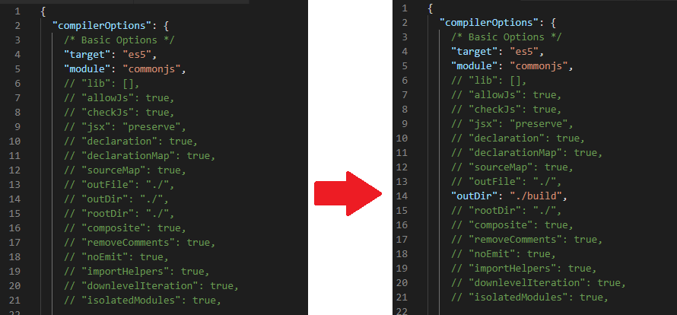
Setup
npm run tsc -- --init

Slide 6
Full Example
import express from "express";
import path from "path";
// initialize configuration
const port = process.env.SERVER_PORT || 3000;
const app = express();
// Configure Express to use EJS
app.set( "views", path.join( __dirname, "views" ) );
app.set( "view engine", "ejs" );
// define a route handler for the default home page
app.get( "/", ( req, res ) =>{
// render the index template
res.render( "index" );
} );
// start the express server
app.listen( port, () => console.log(`Server started at http://localhost:${ port }`));

